Slide 1
vtstrong.vermont.gov/

Slide 2
Project Management Institute Vermont Chapter
“Rebuilding Vermont’s Infrastructure After
Tropical Storm Irene”
∞
Joe Flynn, Director
Vermont Emergency Management

Slide 3
Tonight’s Discussion…
The Problem - Scope and magnitude of what was faced
The Solution - Critical decisions necessary
Deploy an Incident Command System (ICS)
Understanding the landscape and major obstacles
Time management
Communications
Cost management
HR management
Risk management
Quality Management

Slide 4
Hurricane / TS Irene - Storm Tracks
Irene’s Track – August 20th to August 28th, 2011
Irene’s Track across New England August 28, 2011

Slide 5
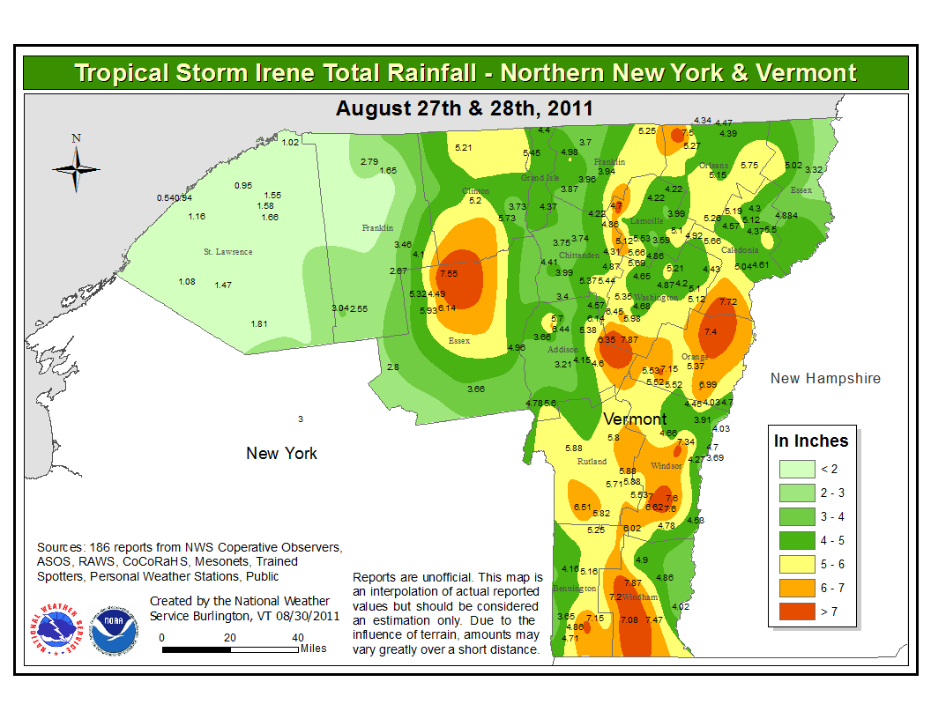
Weather Summary
Rainfall rates were generally .5-1.0 inches per hour, totals statewide were 4-7 inches with higher local amounts (<10 inches)
Flash flooding occurred at headwaters of White, Ottaquechee, Otter Creek, New Haven, Mad, Winooski, Missisquoi and Walloomsac rivers.
Some of Vermont’s larger rivers witnessed NEW record crests equal or greater to Vermont’s greatest November 1927 flood.
Winds - 20 to 30 mph with gusts up to 50 mph

Slide 6
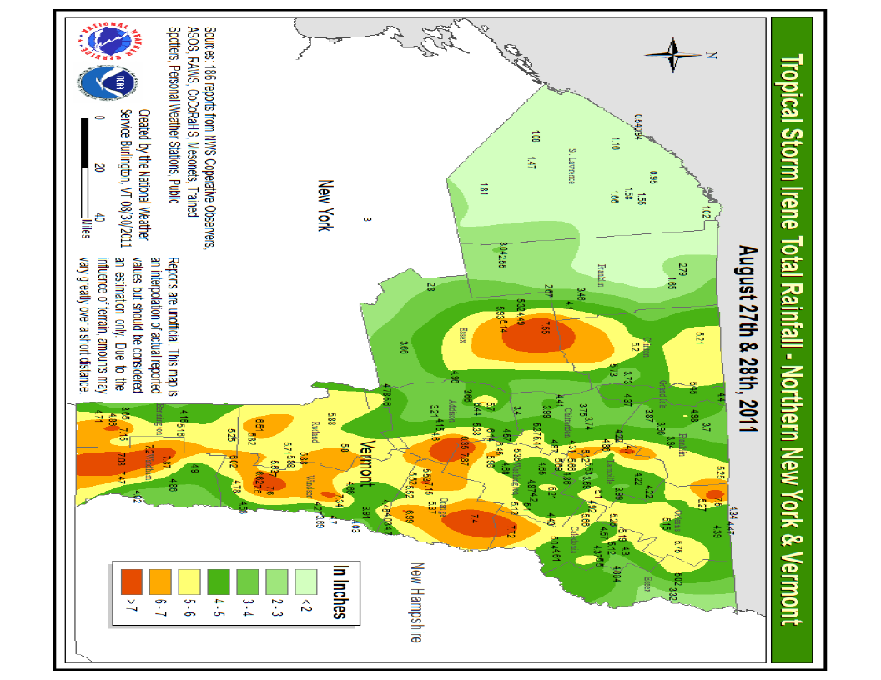

Slide 7
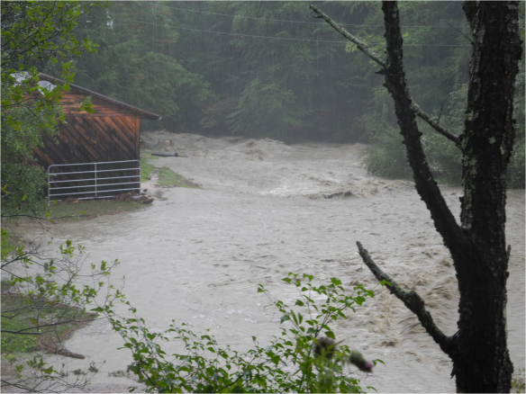
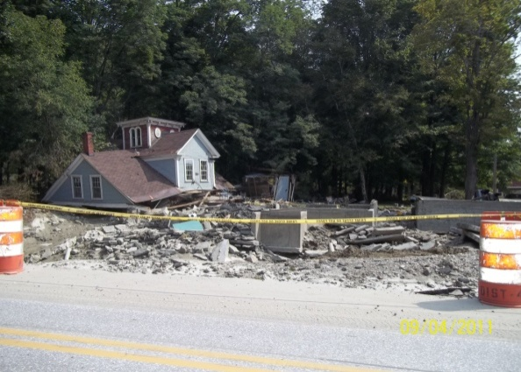
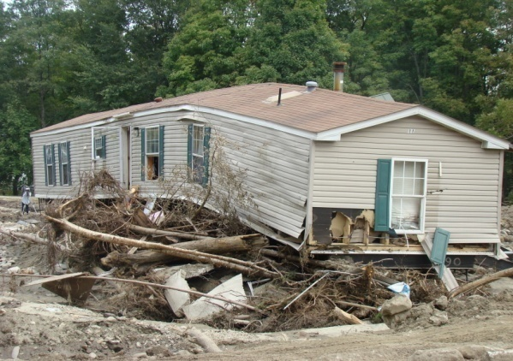
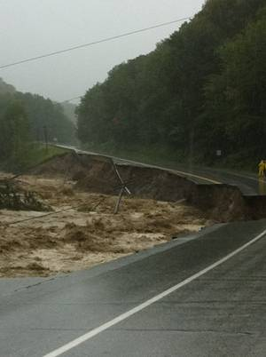
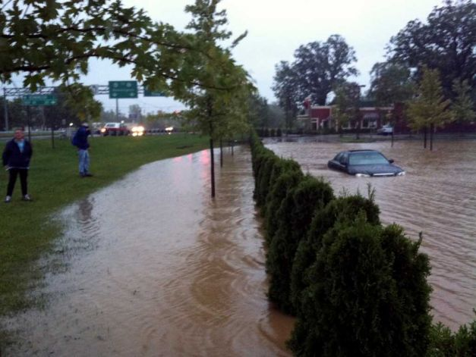
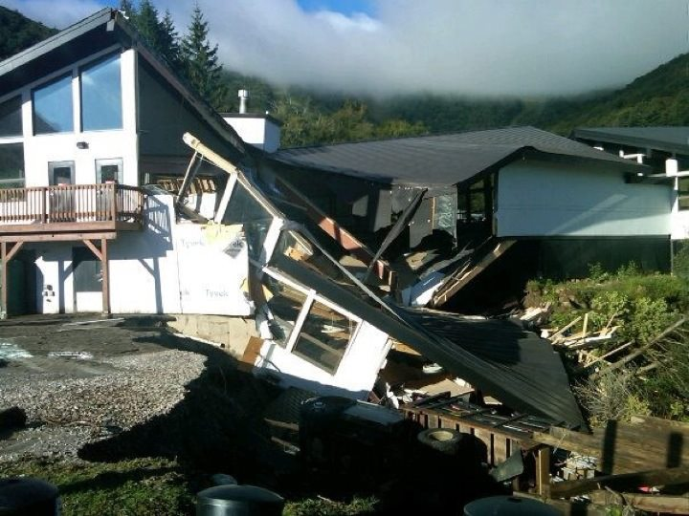
The Flood
Plymouth
Bridgewater Corners
Rochester
Pittsfield
Bennington
Mendon
Killington

Slide 8
US 4
US Route 4
Mendon

Slide 9
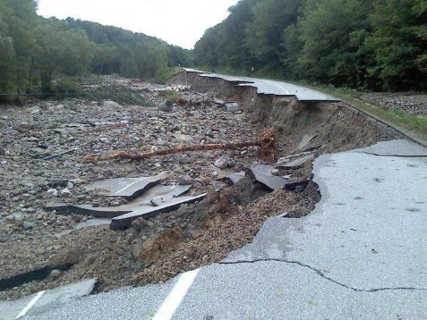
US Route 4 Mendon

Slide 10
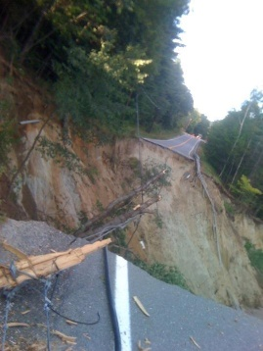
RT 131 Cavendish – “The Cavendish Canyon”

Slide 11
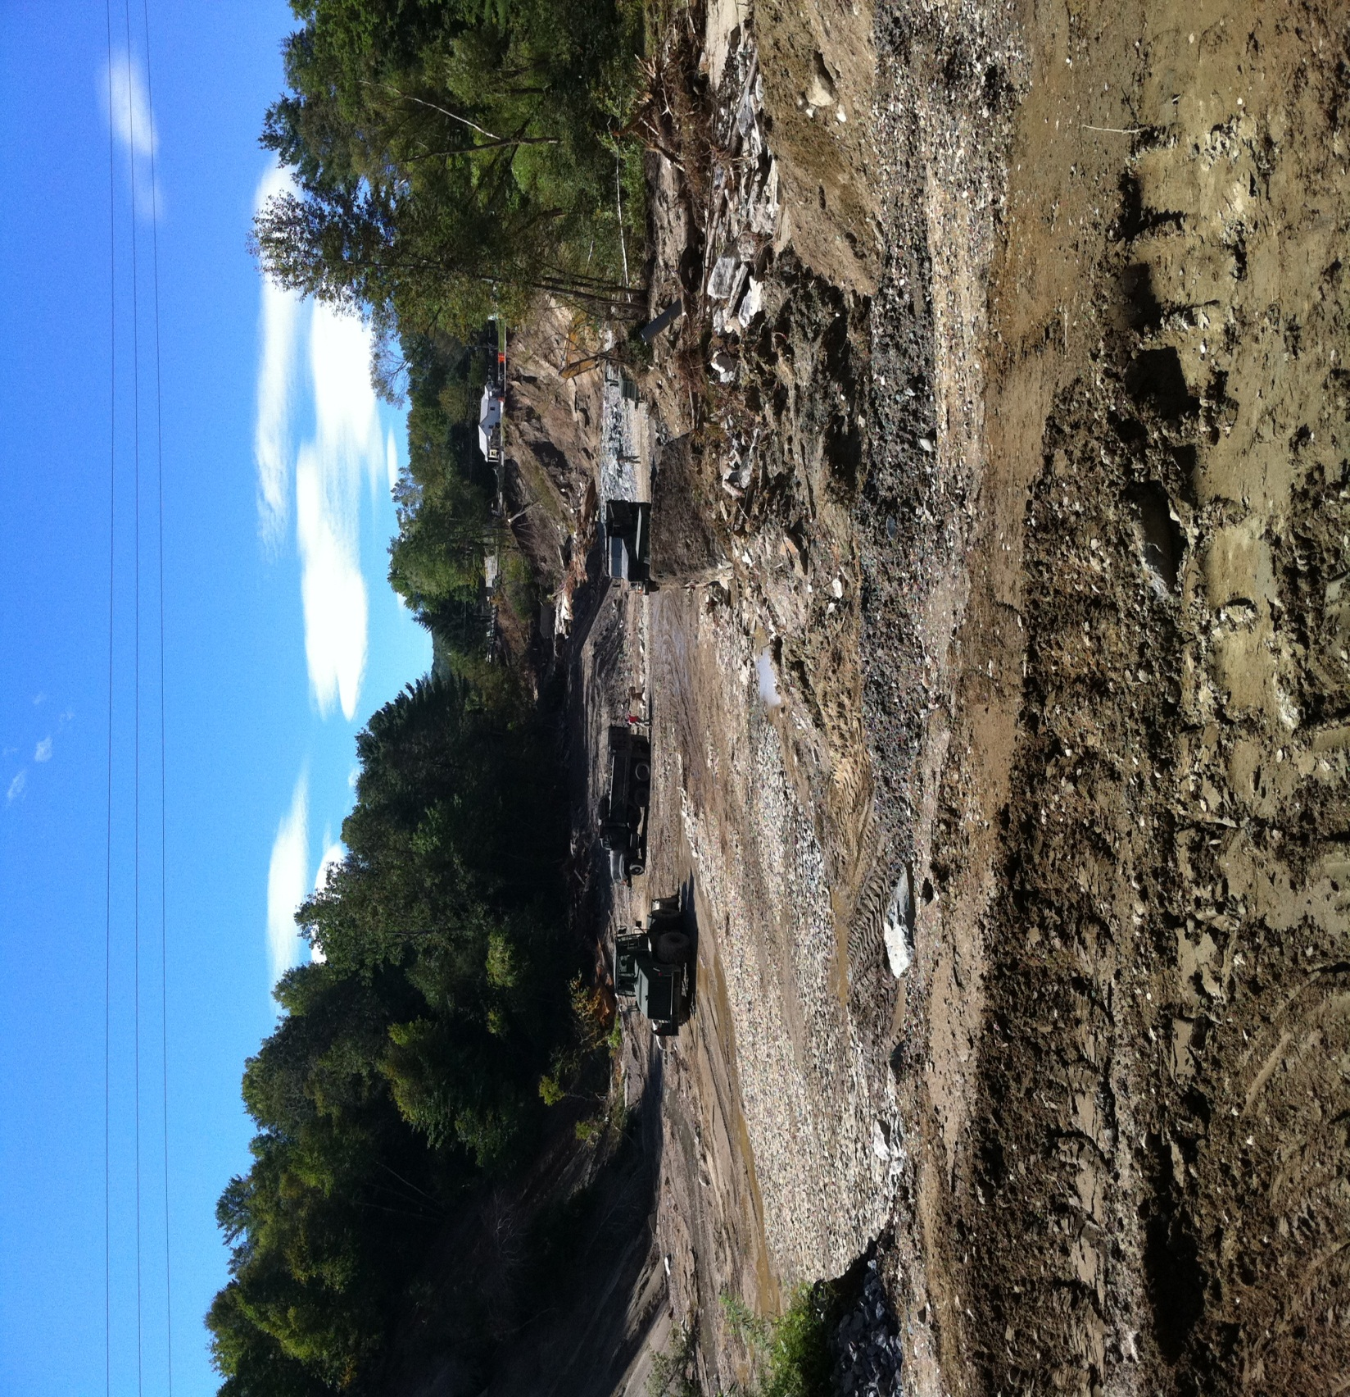

Slide 12
Cavendish Canyon VT 131

Slide 13
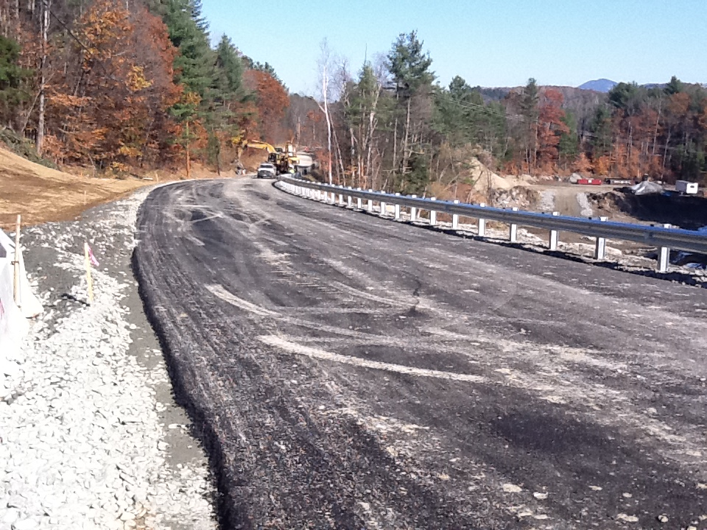

Slide 14
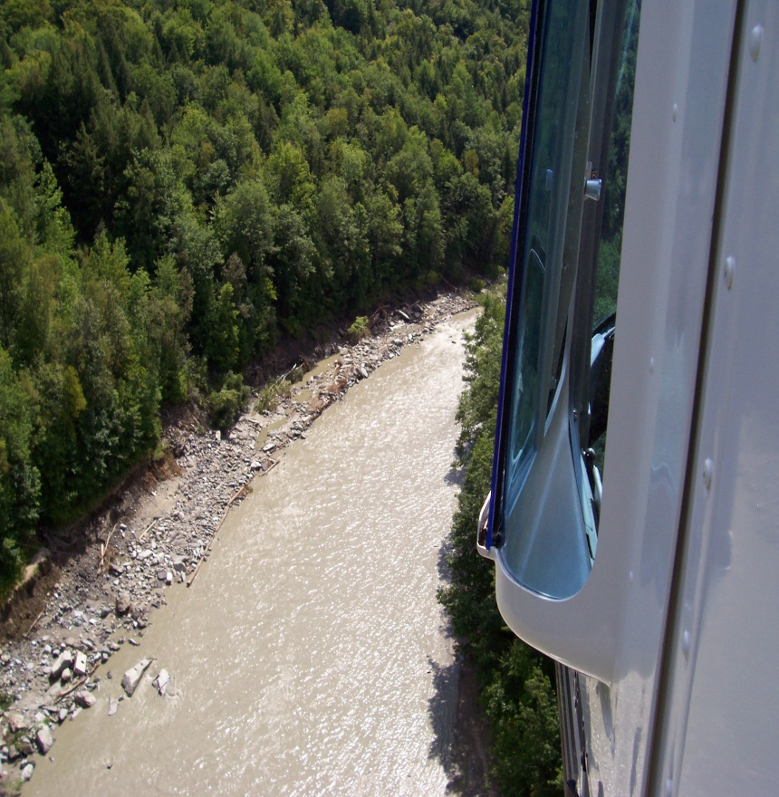
Route 107 - Stockbridge

Slide 15
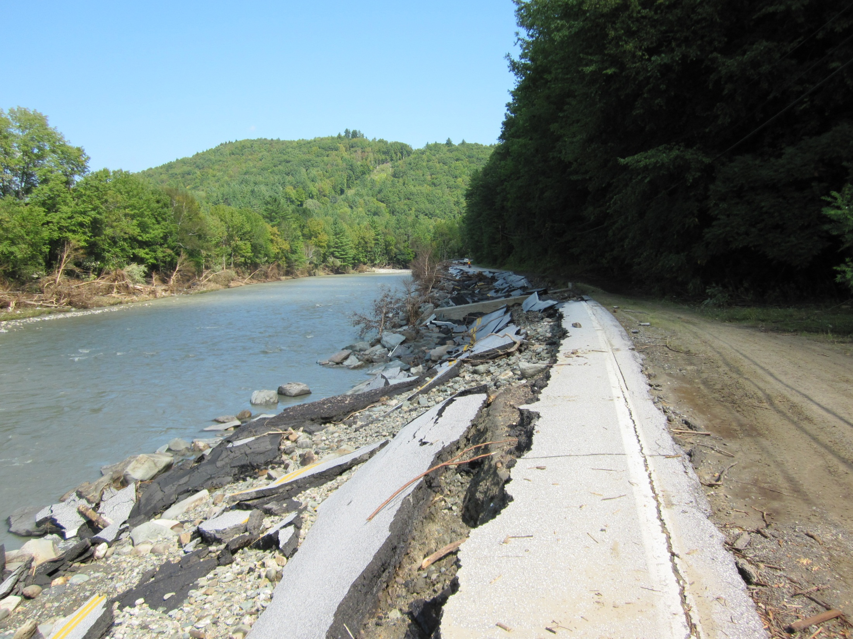
VT Route 107 Stockbridge

Slide 16
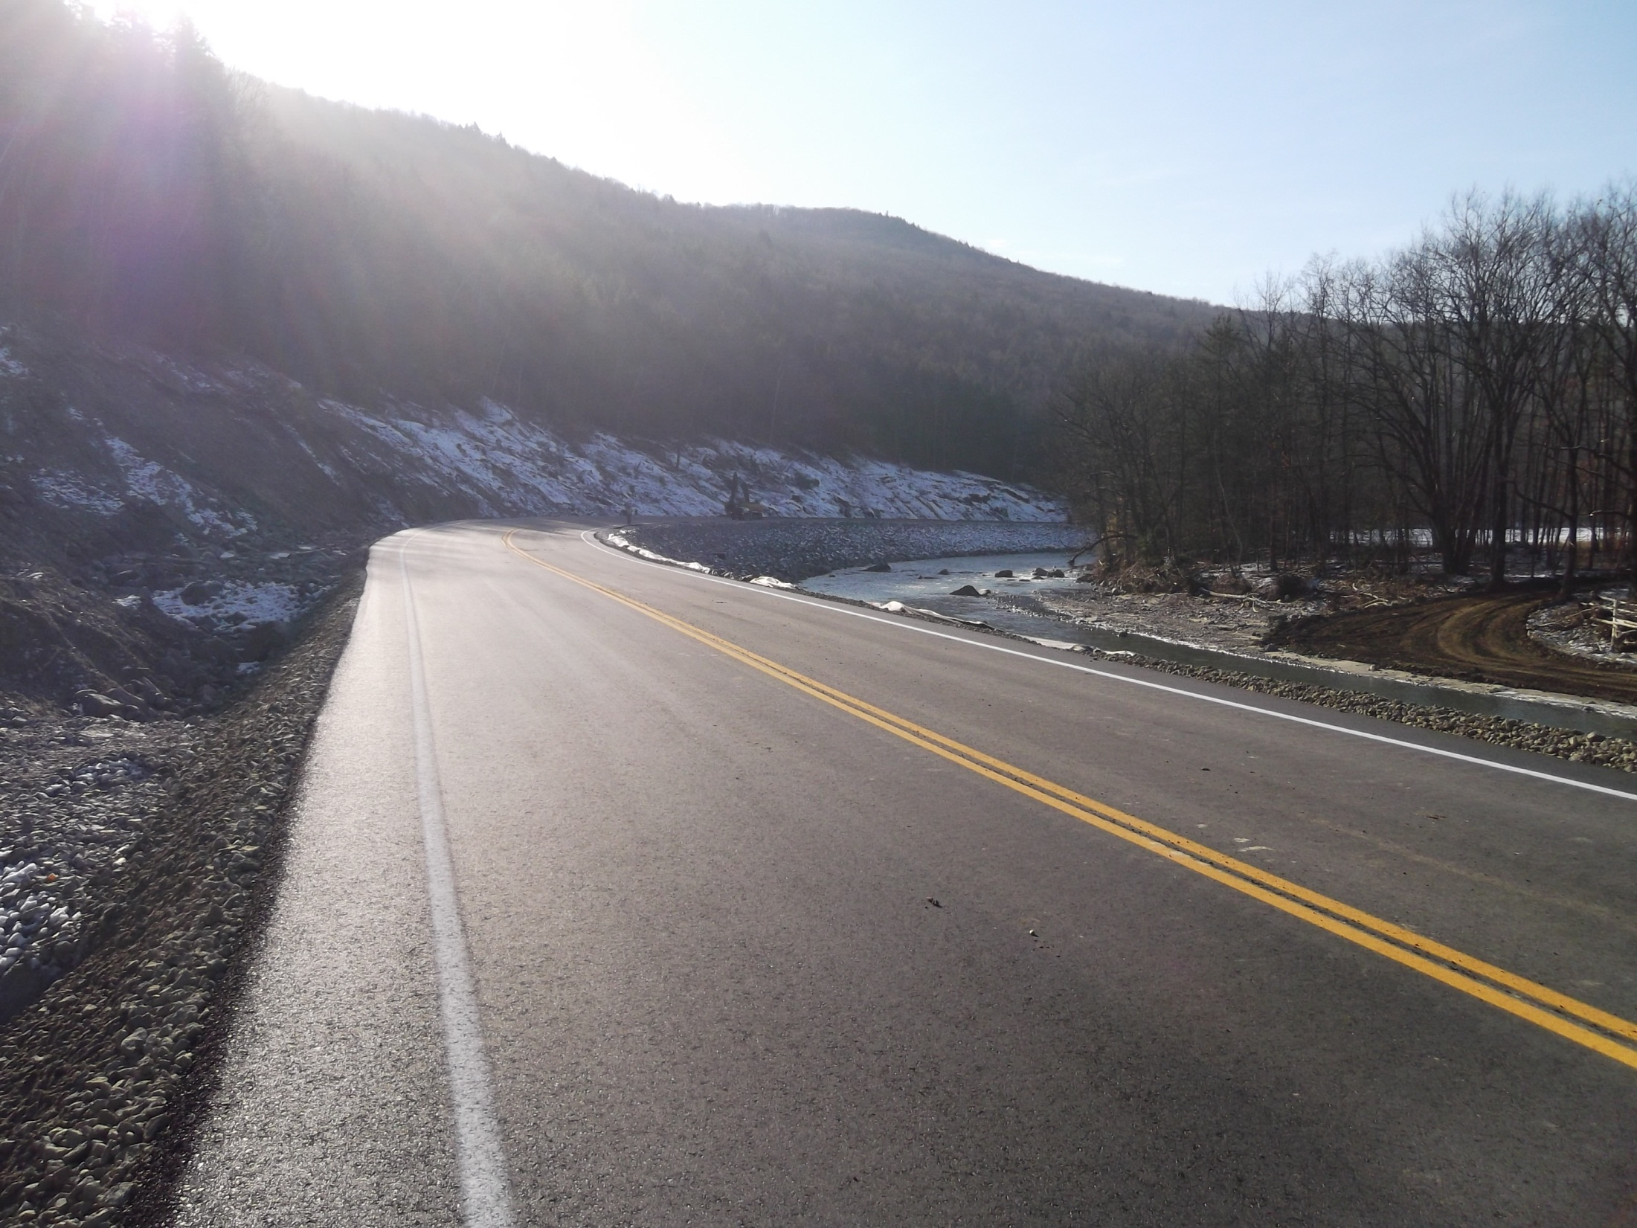

Slide 17
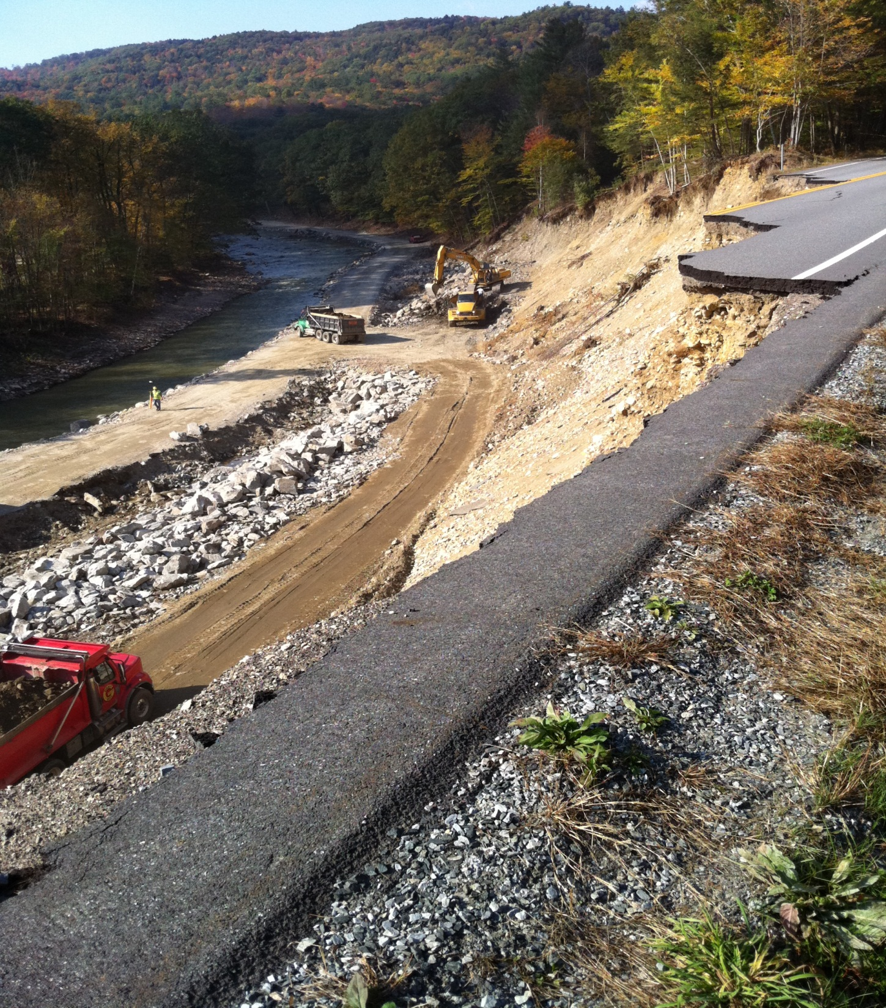
RT 106 Weathersfield
Black River
2,200’ bank gone
450’ road gone

Slide 18
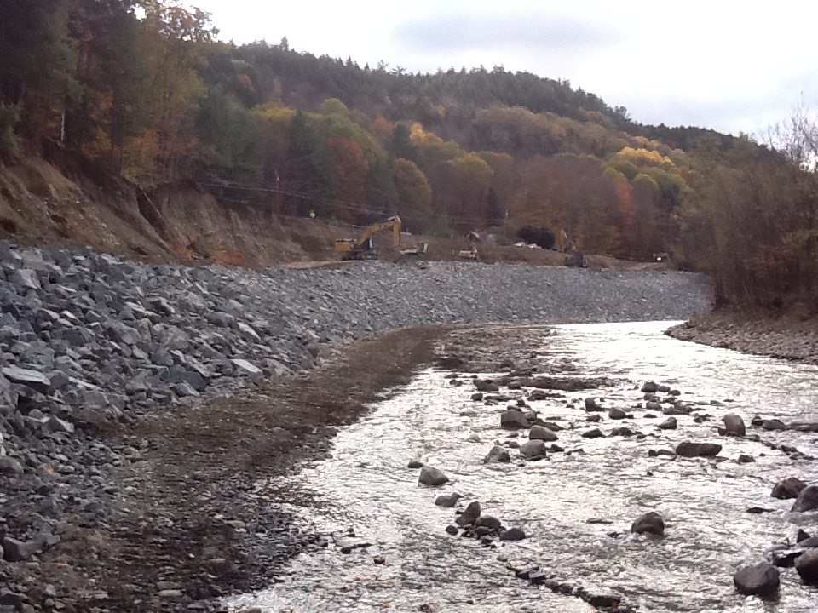

Slide 19
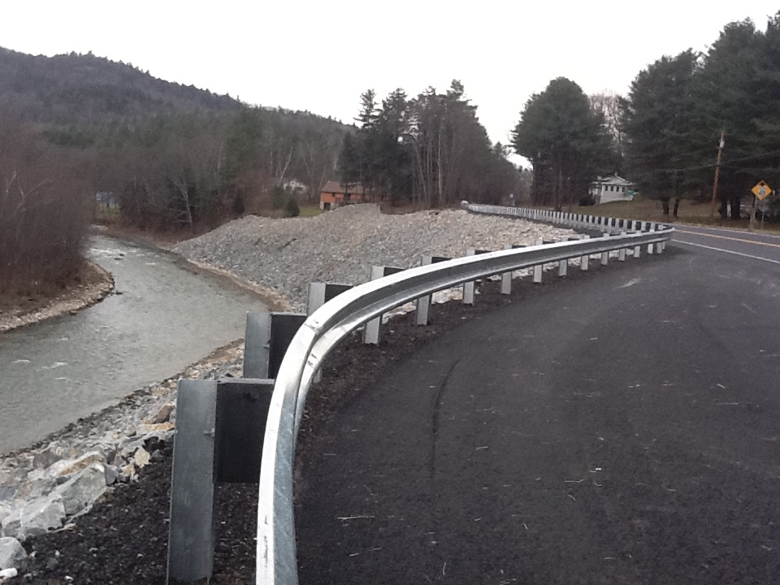

Slide 20
Pittsfield Route 100
Debris
Pile

Slide 21
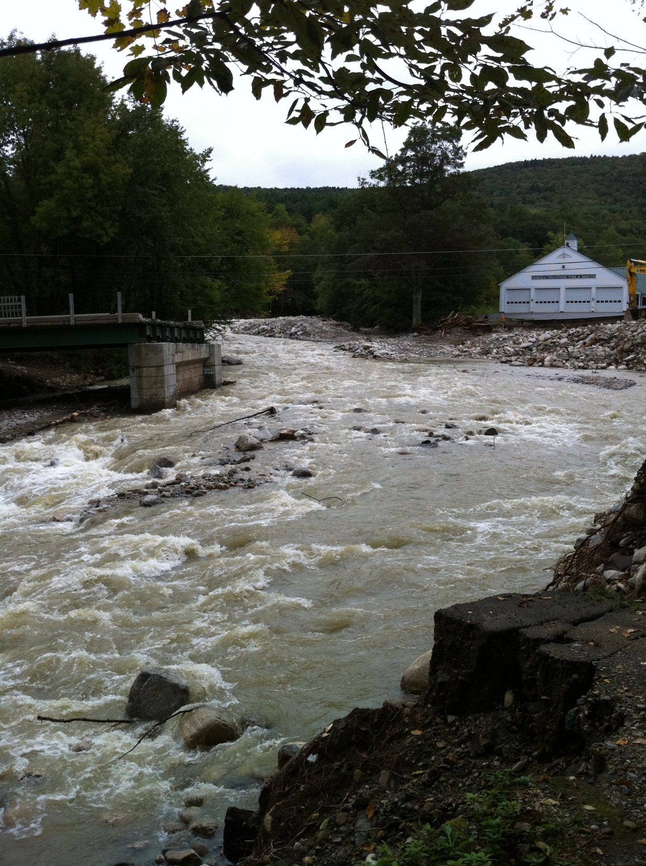
Route 30
Jamaica

Slide 22
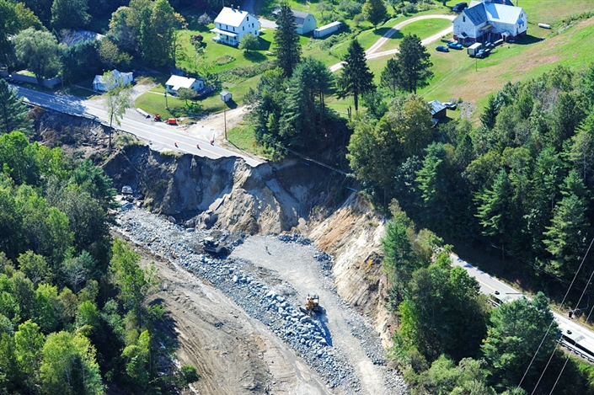
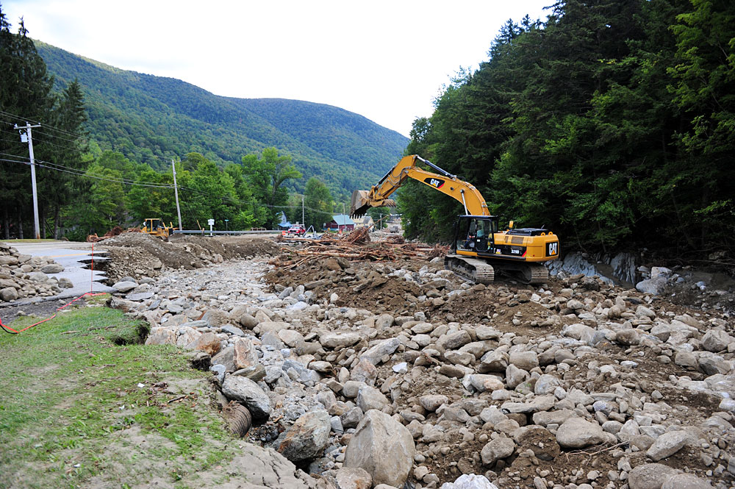
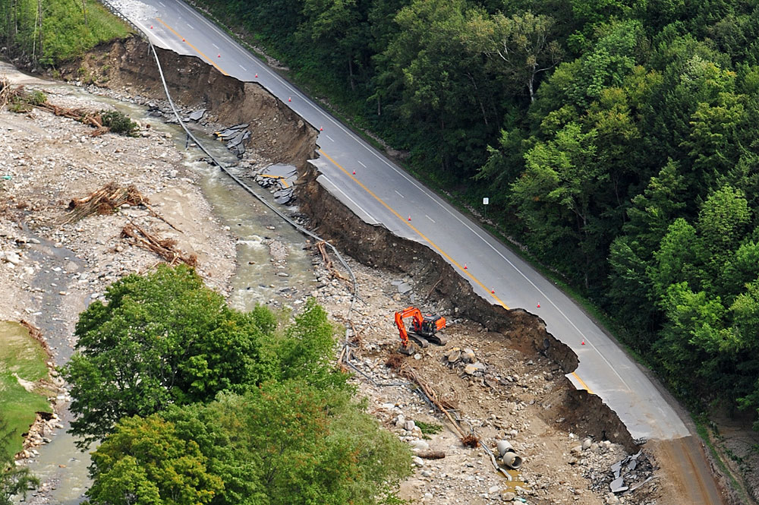
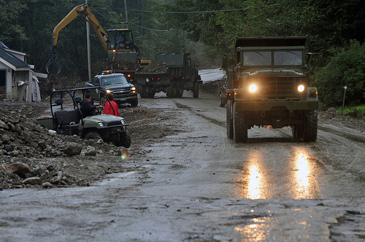
Waterbury State Office Complex

Slide 23
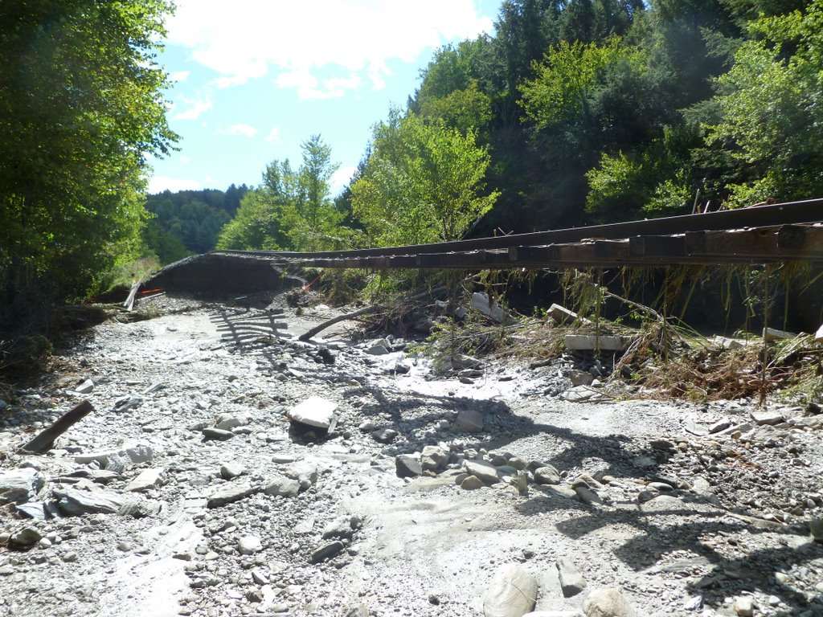
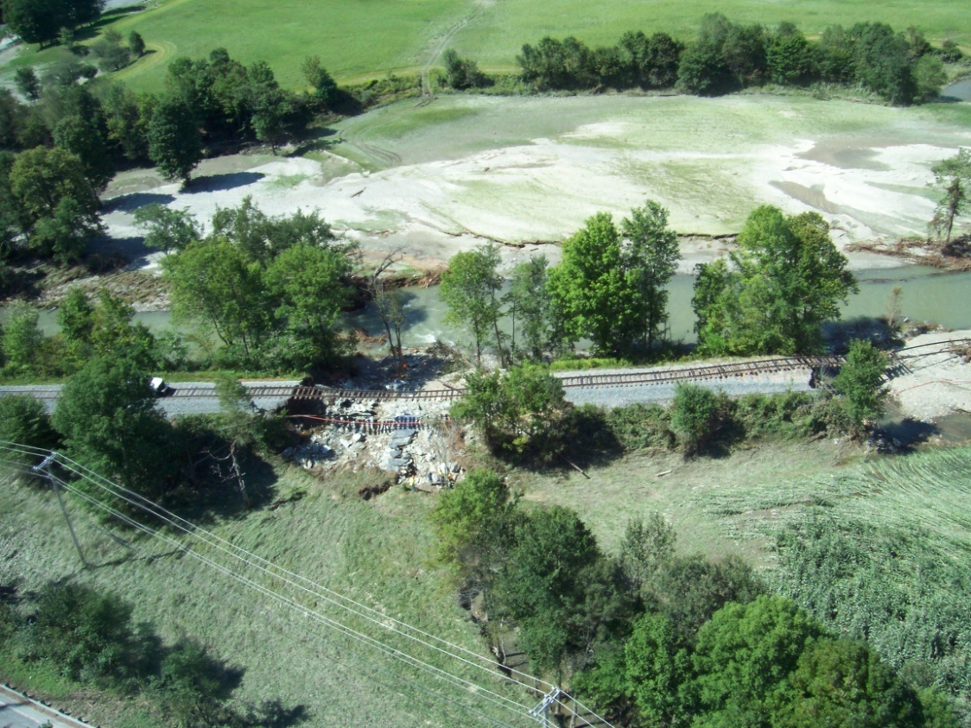
New England Central Railroad

Slide 24
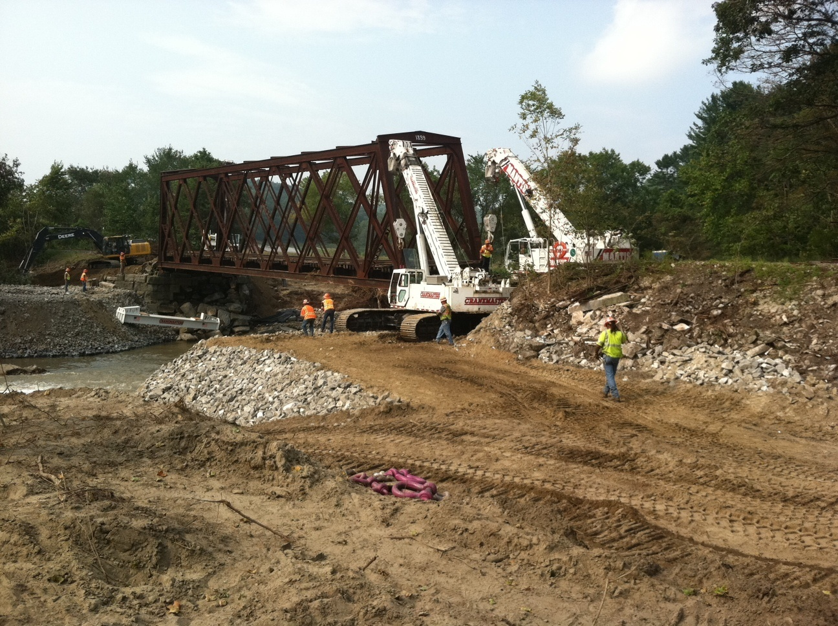
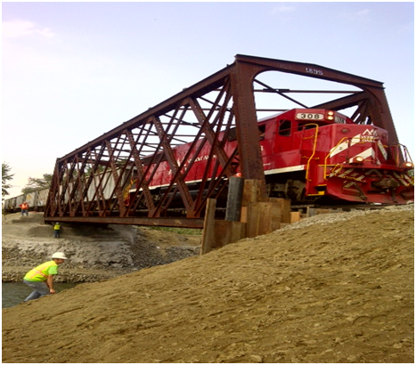
Green Mountain Railroad Bridge 114 Chester

Slide 25
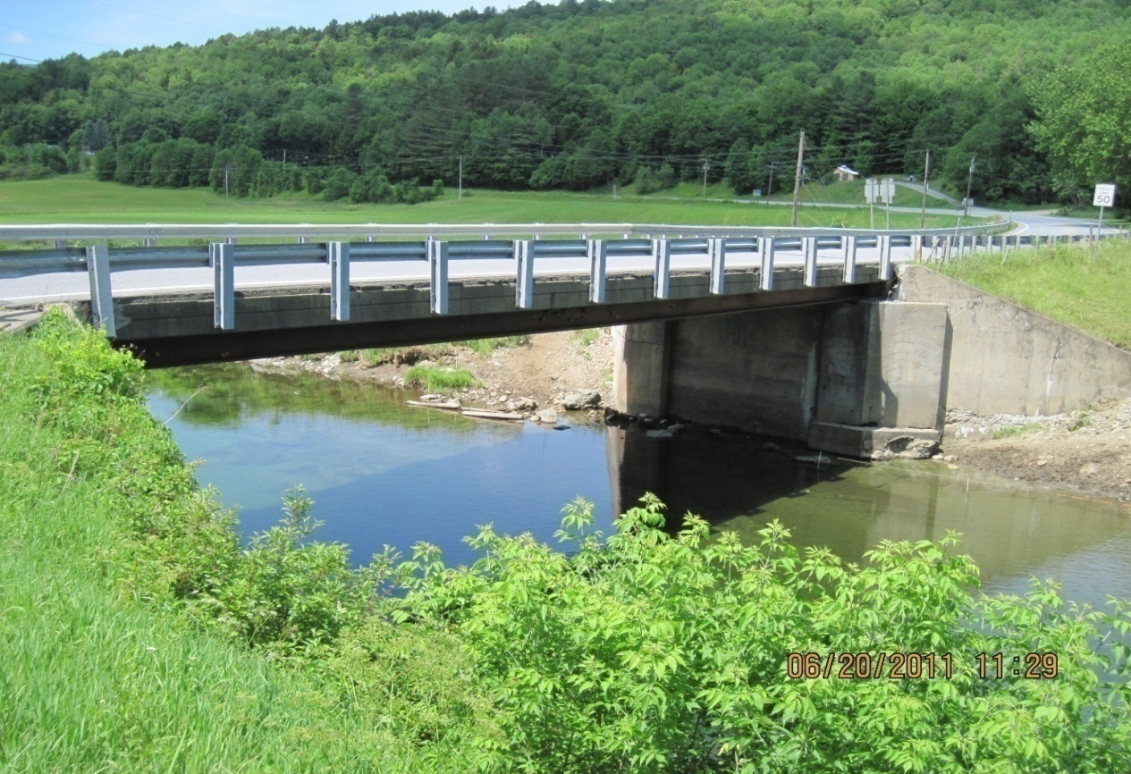
VT 100 and VT 73 Pre and Post- Irene
Installation of a temporary bridge was completed on October 15th

Slide 26
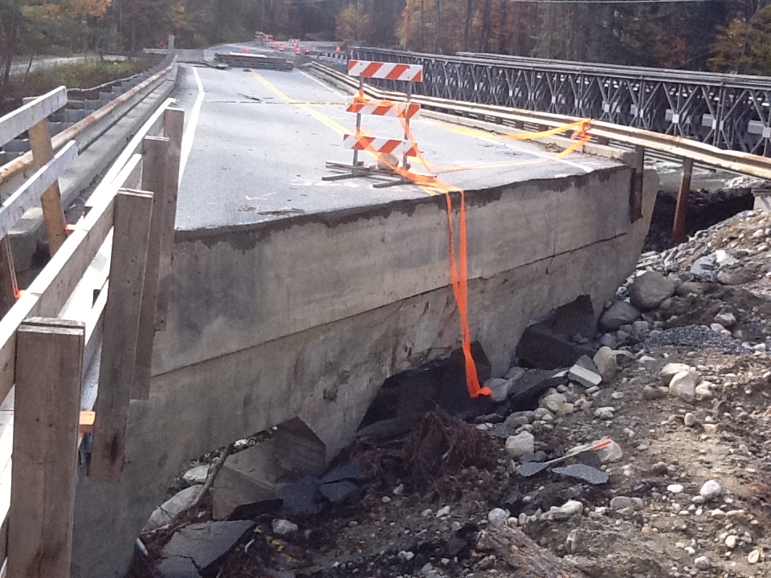

Slide 27
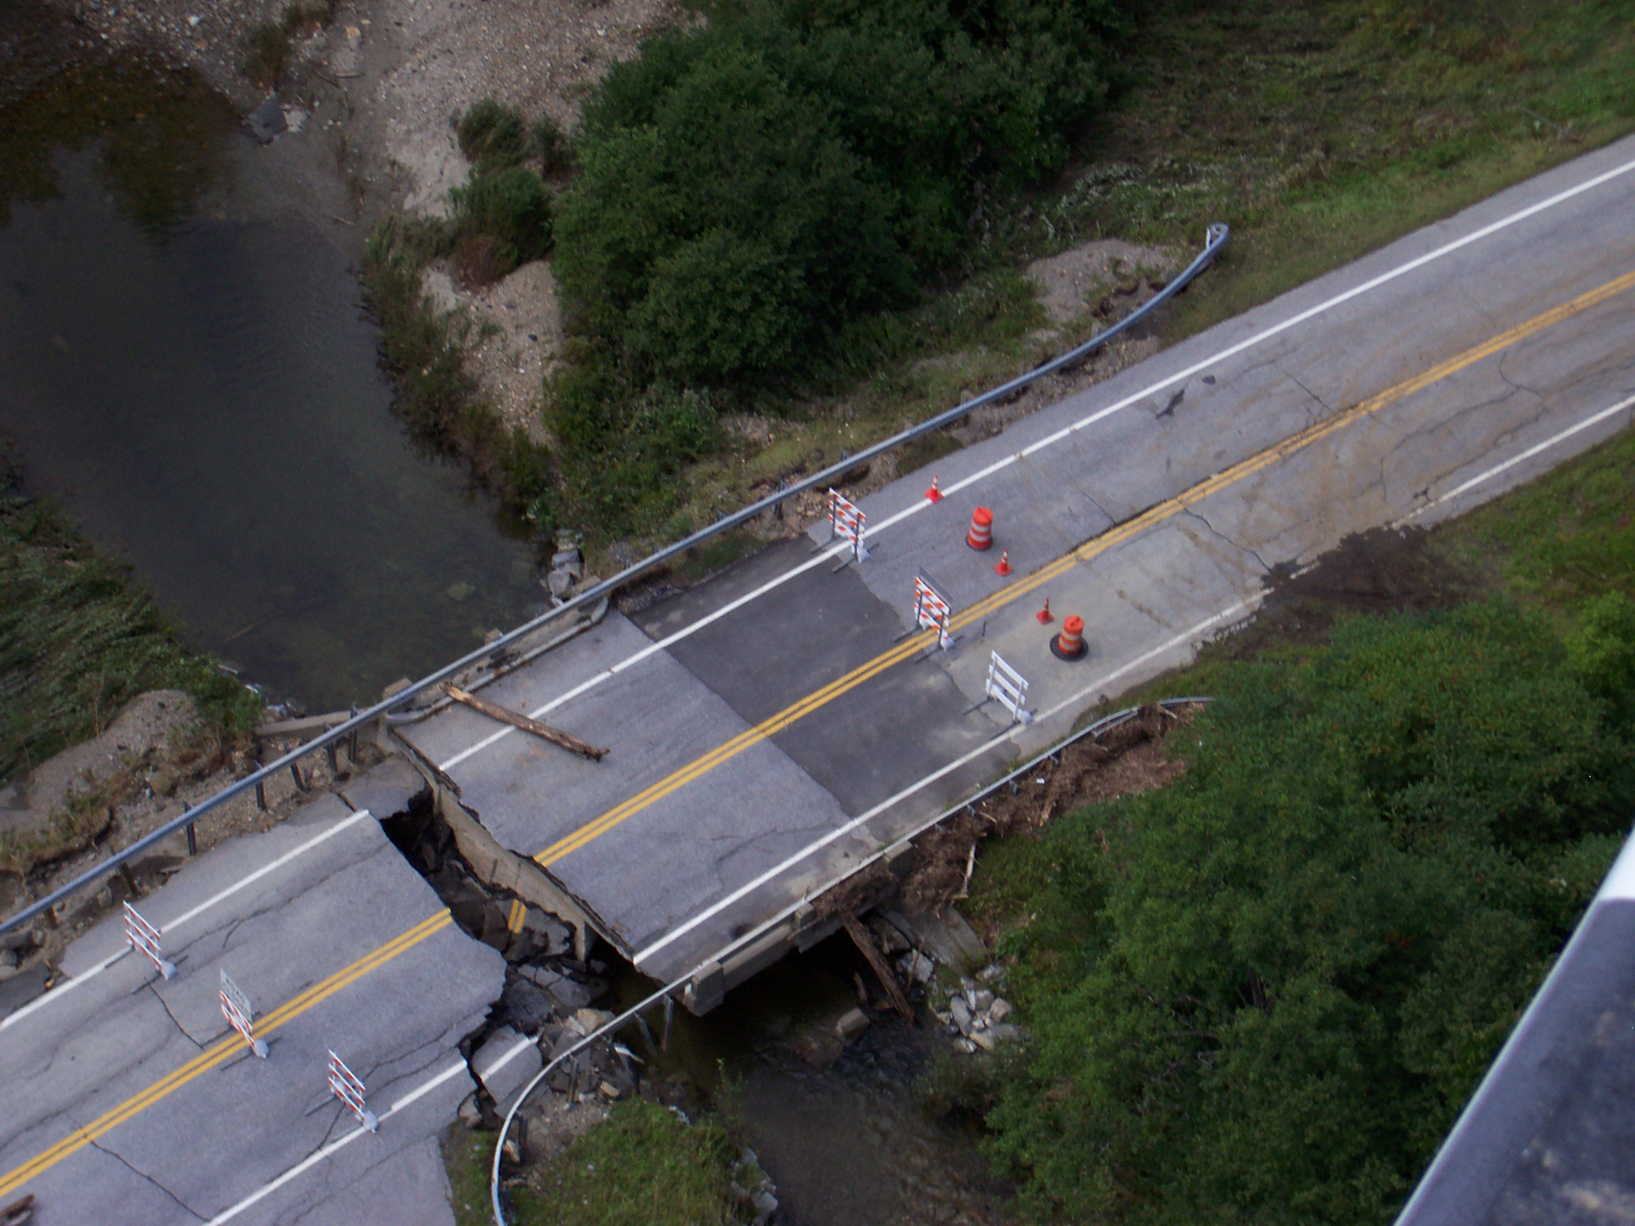

Slide 28
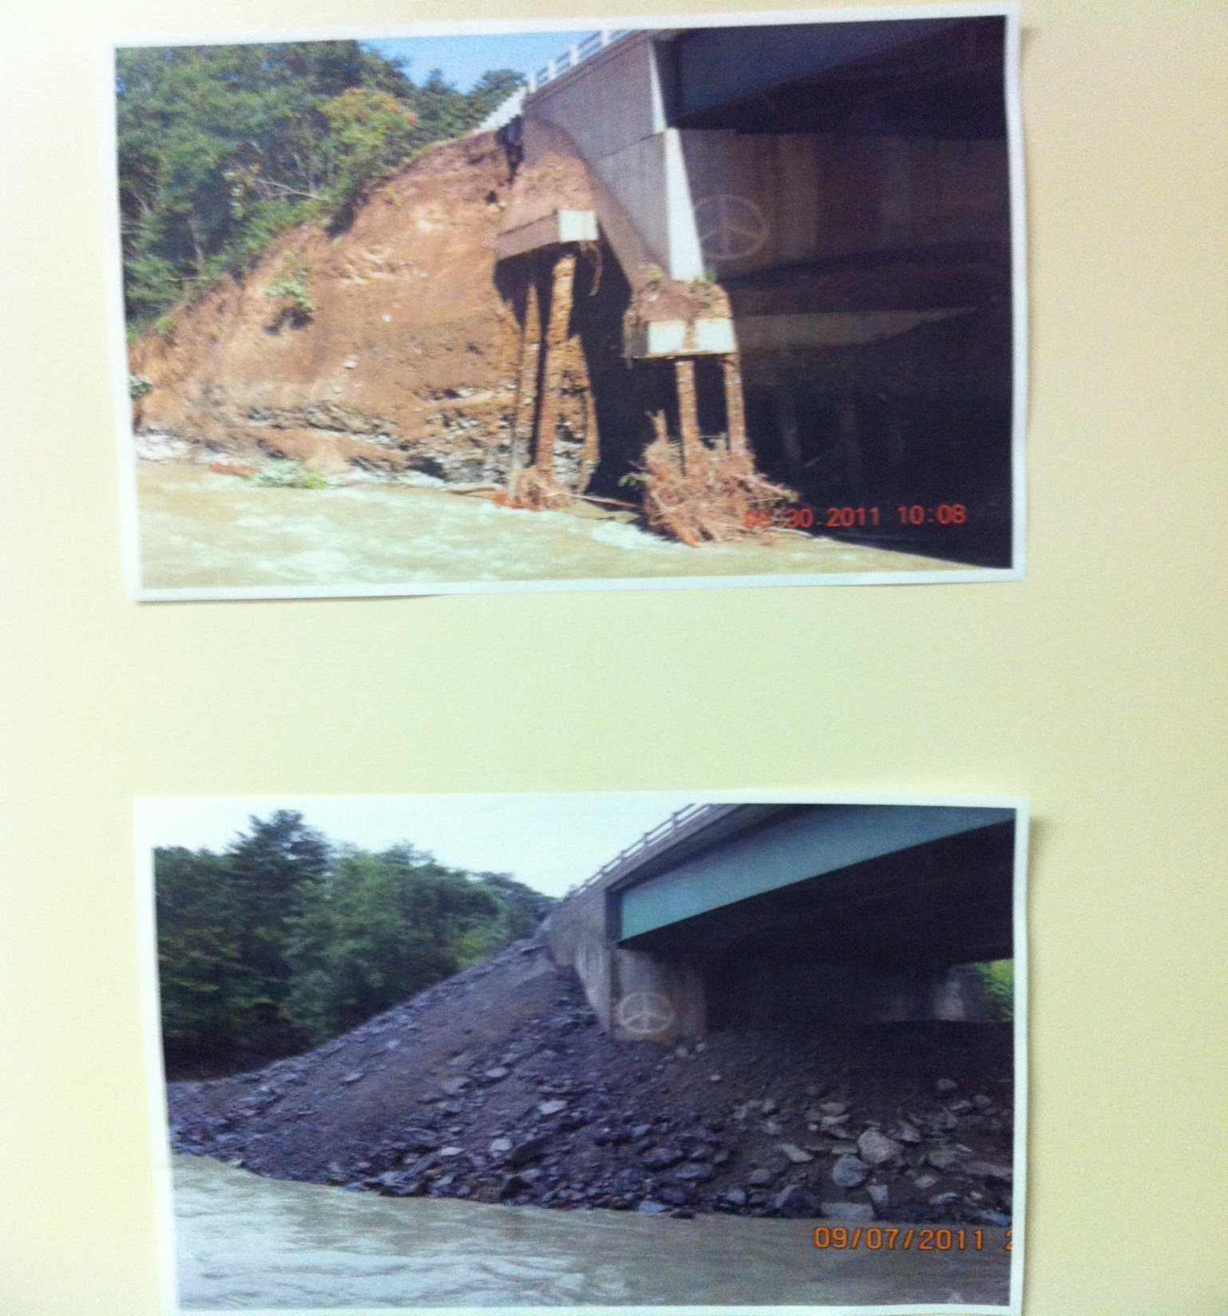
Bridge 9 on VT RT 30 near Newfane
9 days start to finish

Slide 29
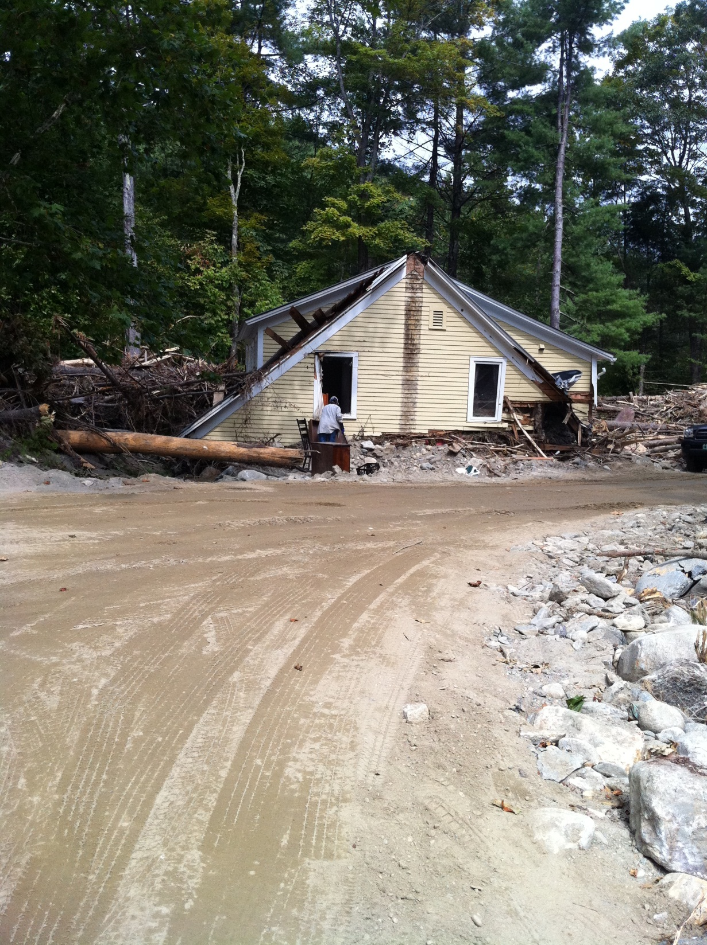
Remains of a home
In South Newfane

Slide 30
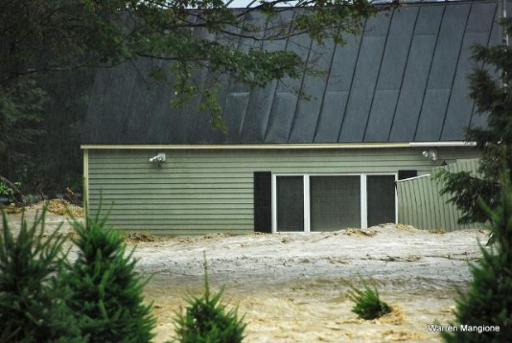

Slide 31
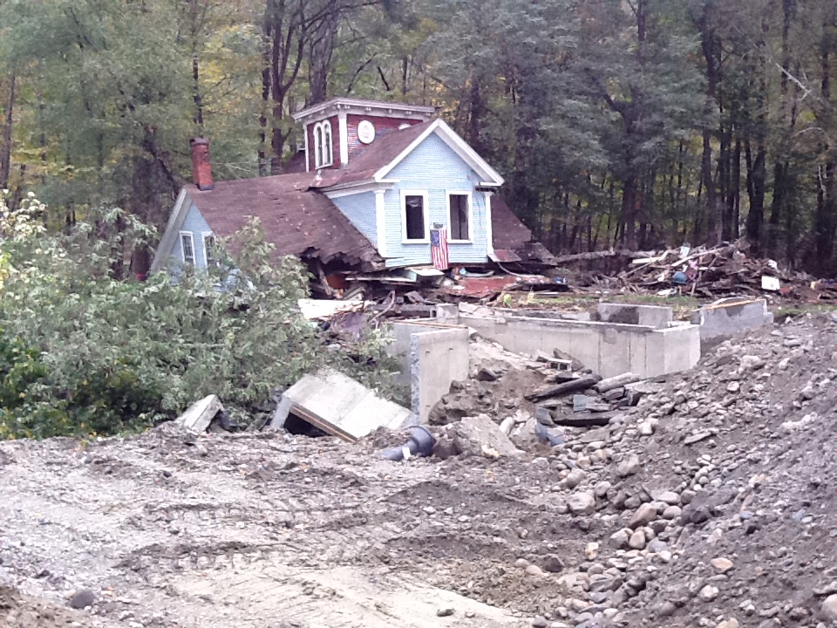

Slide 32
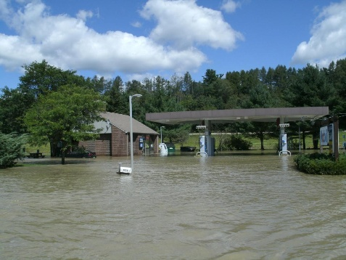

Slide 33
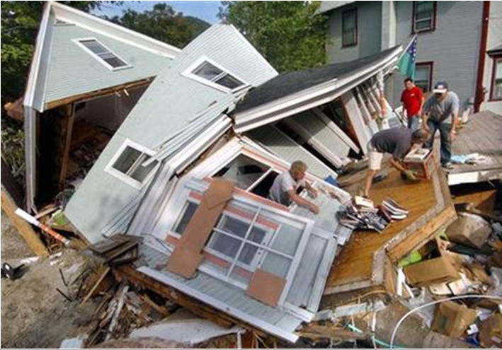
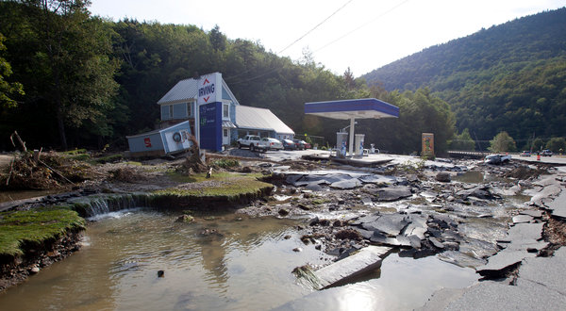
Hazmat & Destruction

Slide 34
Grasping the scope and magnitude of what we were facing – The Problem
6 lives were lost
13 Towns totally isolated with no communications
Devastation of a magnitude few had ever seen before
Critical transportation links (State & local) severed made it impossible to know the real extent of damage
531 miles State road closed
200 State bridges damaged, 34 closed
Approximately 50,000 power outages ; 27,000 in Dummerston ICC area

Slide 35
Critical decisions necessary for the long haul - The Solution
Implement an Incident Command System (ICS) structure
Decision made on Tuesday, August 30th
Incident Command Centers (ICCs) were staffed and operational in Rutland and Dummerston at 0600 on Wednesday, August 31st

Slide 36
ICS ~ (Incident Command System)
The ICCs are operated by a Unified Command (UC) in Montpelier. The UC role was to set priorities, provide overall management through directives, and take the lead on communication and public information. The UC was given direction by the Secretary’s Office.
SECRETARY’S OFFICE
UNIFIED COMMAND
Director of Operations & Director of Program Development
Dummerston
Northern Regions
Rutland

Slide 37
Safety Officer
Incident Commander
Information Officer
Liaisons
Operations
Planning
Logistics
Administration
District
Garages
Utilities
Communications
Time
Resident
Engineers
Inspectors
Supplies/
Equipment
Procurement
Contracts
Private
Contractors
RPCs
Facilities
Compensation
Claims
Bills
Staging
Areas
Environmental
Hazmat
Food
Basic Needs
Records
National
Guard
ICC Commanders
Dummerston: Joe Flynn
Rutland: Gil Newbury
Northern: George McCool
Town
Crews

Slide 38
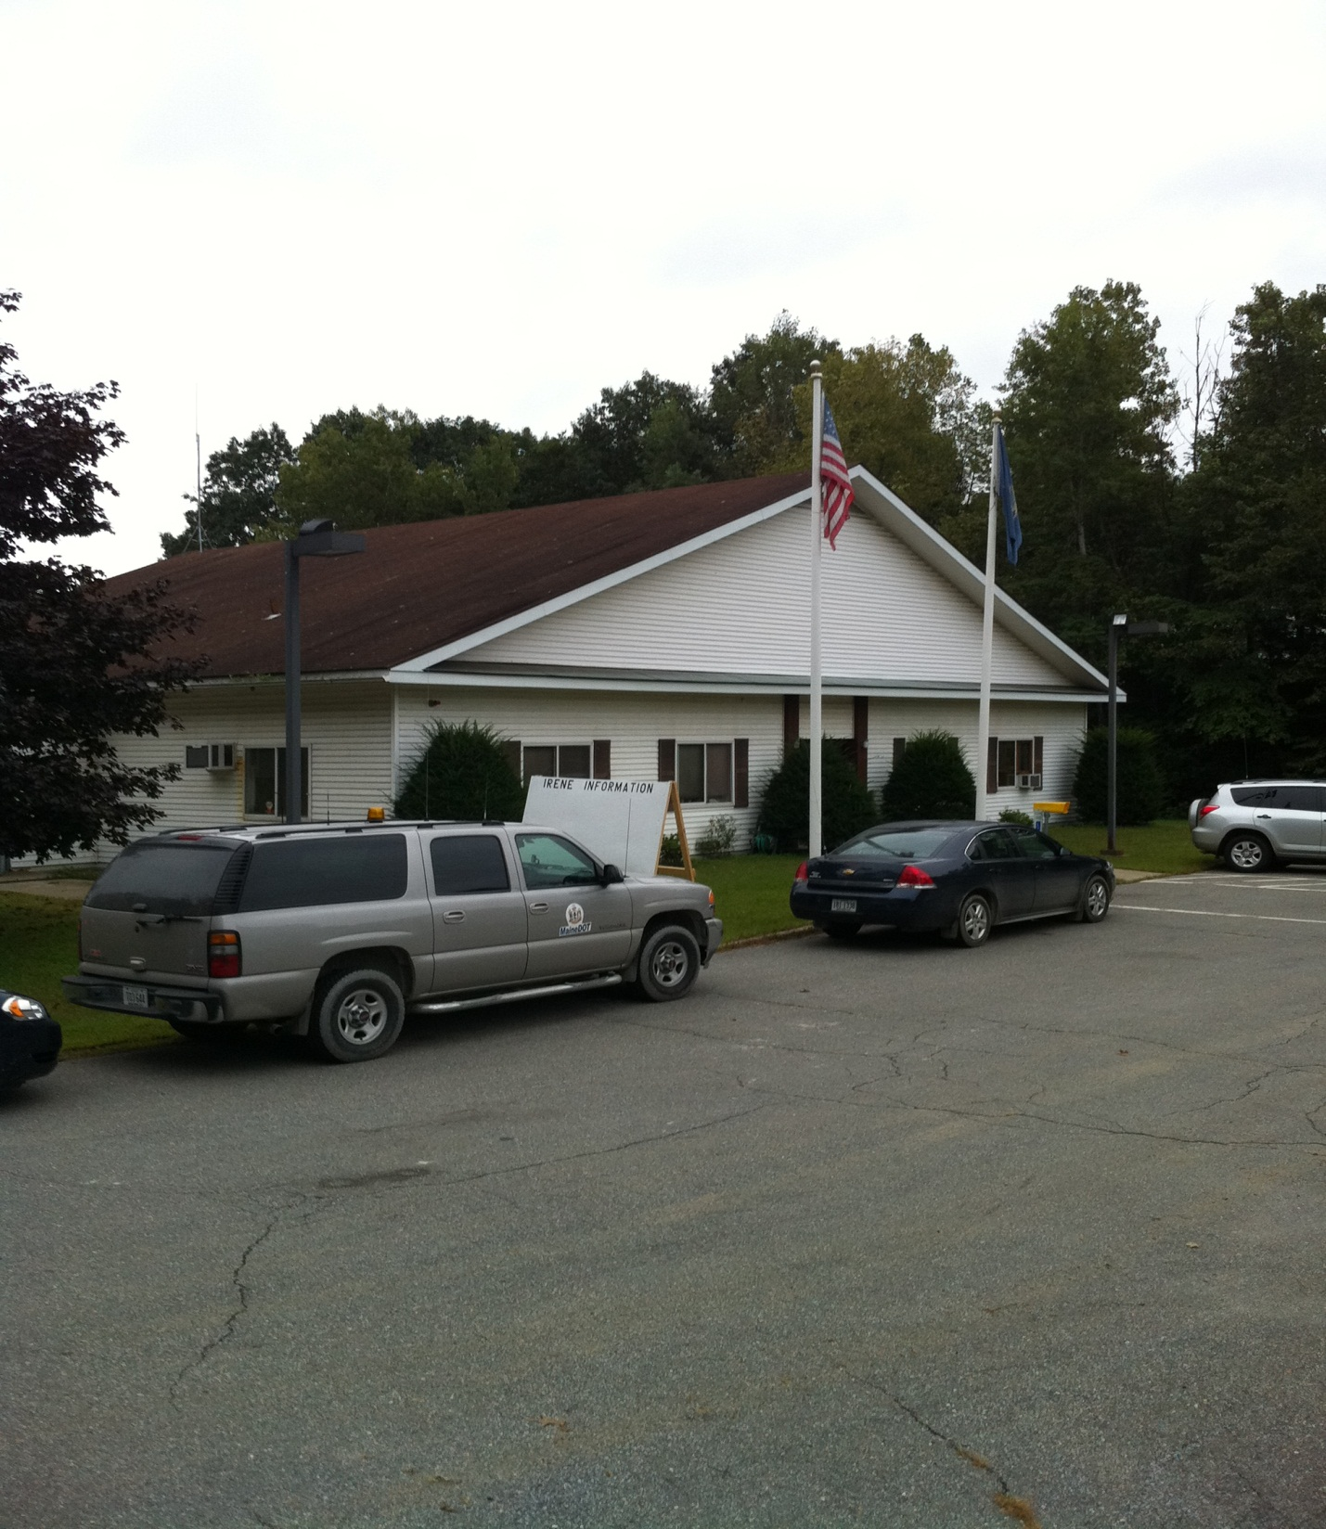
Dummerston ICC located at VTrans D2 facility on Putney Road
Dummerston ICC covered 56 towns –

Slide 40
Activity at Dummerston ICC

Slide 41
Meetings and Map Reading

Slide 42
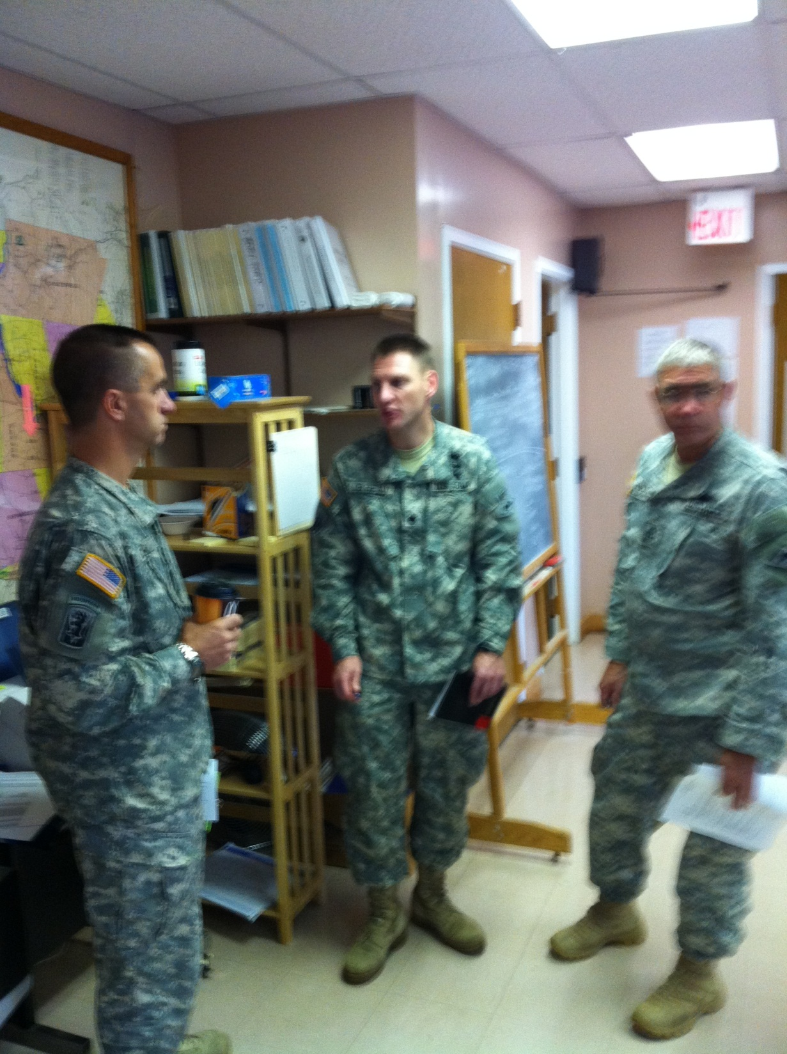

Slide 43
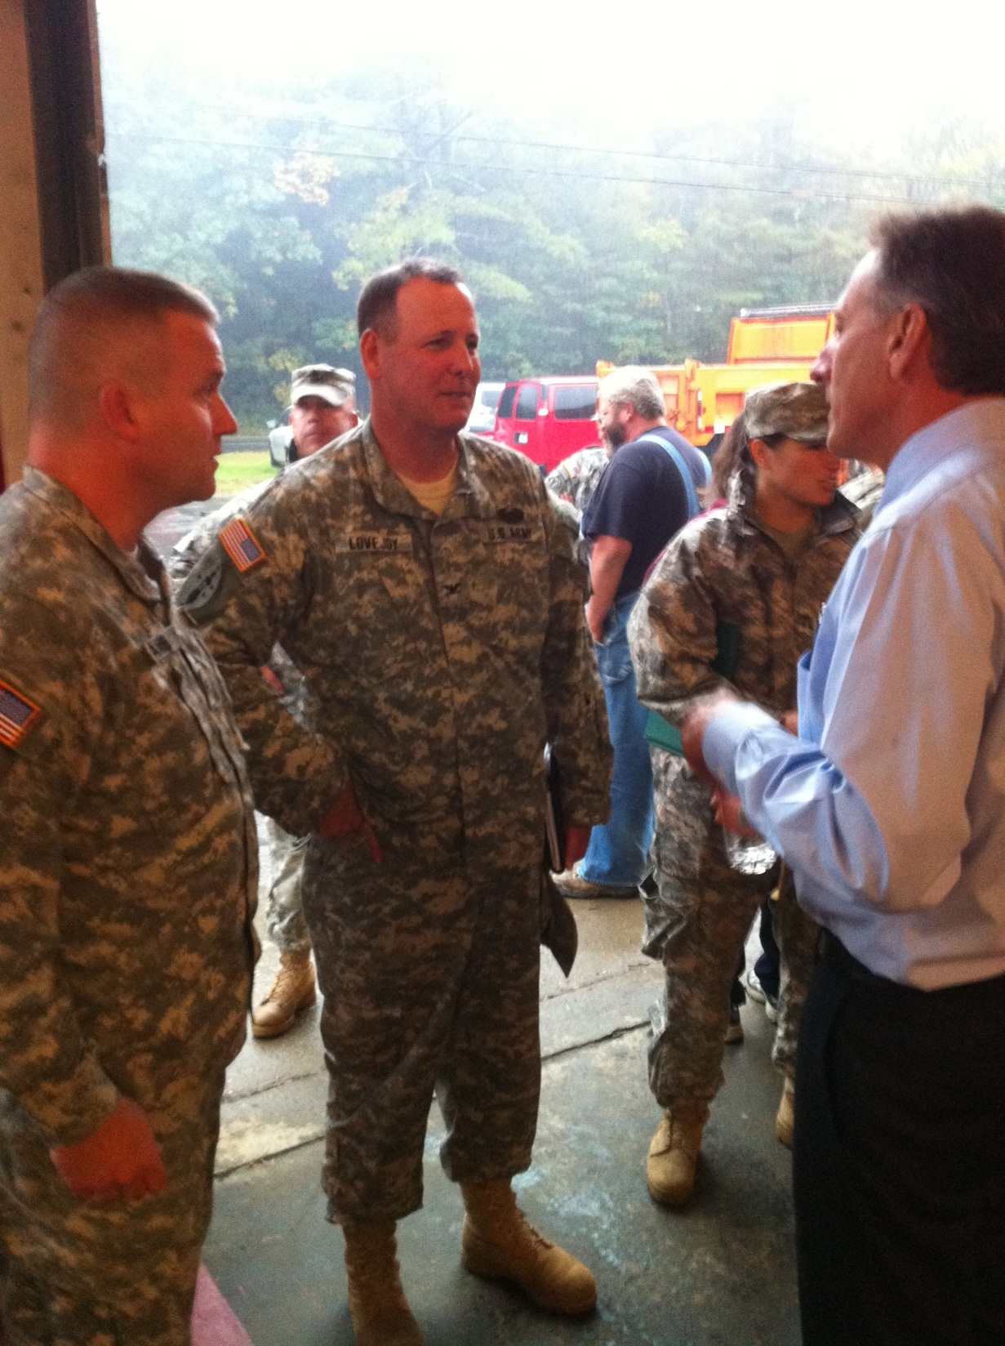

Slide 44
Understanding the landscape and major obstacles –
Telecommunications were down
VTrans District 1 radio system was down
Southern Vermont - poor cell coverage
Information flow to-and-from Montpelier, and amongst responders, was very difficult.
Scope of problems was broad (debris, hazmat, scour, landslides, utility damage, structural damage, etc. )
Scope of damage to Towns - impossible to quantify
Response to the emergency could not be effectively managed by following normal operating protocols

Slide 45
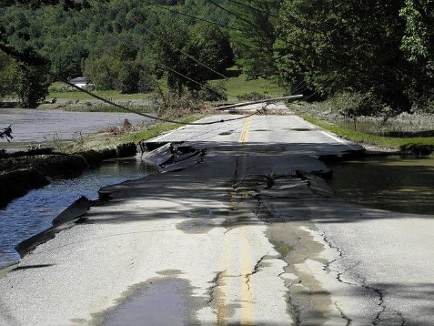

Slide 46
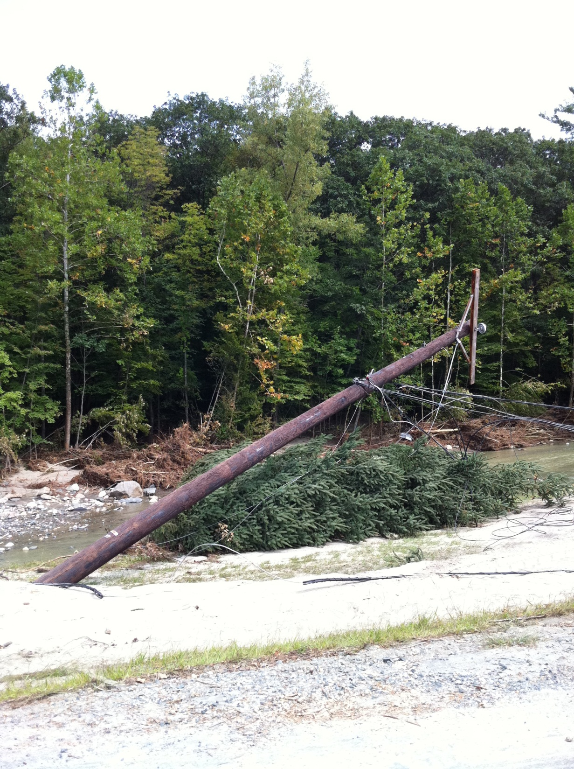

Slide 47
Our Goals
Establish emergency access - cutoff/isolated towns & locations within communities
Establish access for utility companies - restore power to areas that are still cut off
Establish public mobility - towns that had emergency access only
Establish East/West mobility - along corridors (to include truck traffic/commerce)
Inspect all bridges of concern
Prepare for winter operations
47

Slide 48
Time Management
First 5 days - nearly 24/7
Established hours - 6 AM to 10 PM for public access,
7 days a week
Staff briefings at 7 AM and 7 PM - 7 days a week
Conference calls to (UC) were 9 AM, noon and 6 PM
GIS data transfers twice daily at 9 AM and 2 PM
Public Information Officer call daily at 1 PM
Field operation hours ran dawn to late evening
Planners worked by the project often until done
Logistics and admin 12 to 14 hours daily

Slide 49
Communications
To aid the public in obtaining up-to-date information AOT…
Established a Call Center (1-800-Vermont) with 20 lines
Established a dedicated IRENE e-mail address
In partnership with established a Damage Map
Updated AOT Web (www.aot.state.vt.us ) twice daily
Established social media: Facebook.com and Twitter
Provided regular press and media announcements
Established contacts with RPCs to aid in local assistance
Ongoing communication with Agency partners: ACCD, VDTM, ANR, DEC, BGS, and Governor’s Office
Procured Satellite phones, two-way radios and resorted to whistles and flares in certain locations

Slide 50
Cost Management
Managed costs by utilizing Maintenance Rental Agreements (MRA’s)
Repairs were already in progress when ICC established
Developed and implemented Bid Contracts
Contractors notified by telephone
onsite meetings were scheduled
Generally called between 3 and 5 contractors for any given job.
Required to submit bids 48 hours later.
Bids delivered to and opened at the ICC
Contract was awarded to the lowest
Operations chief signed it signifying approval for the contract and the contractor.

Slide 51
Cost Management - continued
Final step: contractor signed the contract and received a notification to proceed
Resident Engineers were assigned to each project
Bundled Maintenance projects of similar type and location

Slide 52
Risk Management
Public safety vs. Repairing the infrastructure
Prioritized repairs
detour length; extent of extra travel for public
traffic volume
type of road used for that travel
greater the risk for personal injury
Considered conditions further up or down the route which might limit public access.
Accommodate deliveries of supplies based on public safety and the increase of large construction vehicles.

Slide 53
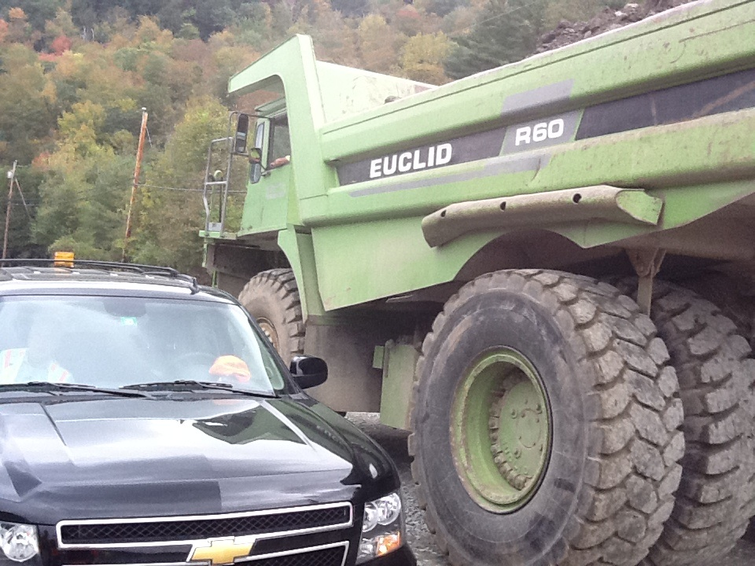

Slide 54
Risk Management - continued
Engineered vs. Un-Engineered repairs
Managed risk - permanent vs. temporary
Detour length and geometry
Condition of the road prior to TS Irene damage
Magnitude of the damage
Engineering Bridge Projects

Slide 55
HR Management
Previous chain of supervision moot
IC complete supervisory authority
Policies were altered on comp-time vs. paid time
consideration for weeks and months employees were away from their families
IC allowed and authorized to conduct all necessary business to forward the mission

Slide 56
Quality Management
Infrastructure repair began Sunday August 28th.
First three days repairs were all maintenance driven; decisions about material and construction methods made by foremen and maintenance supervisors.
The ICC assigned experienced Resident Engineers to projects based on the type and magnitude of the repair such as bridge projects and large slope/roadway failures.
Smaller straight forward projects remained as maintenance driven projects with Resident Engineers assigned to several projects.

Slide 57
Quality Management - continued
Plans and material specifications developed on complex projects (RT 107 Stockbridge, RT 106 Weathersfield, RT 131 Cavendish, Dover Road (FAS) Newfane) to eliminate the risk of substandard materials and methods
Bundled projects – ensure quality of a specific task, i.e. contractor tasked with cleaning gravel from under a bridge and reestablishing a channel will perform the task consistently and will become more efficient with each structure.

Slide 58
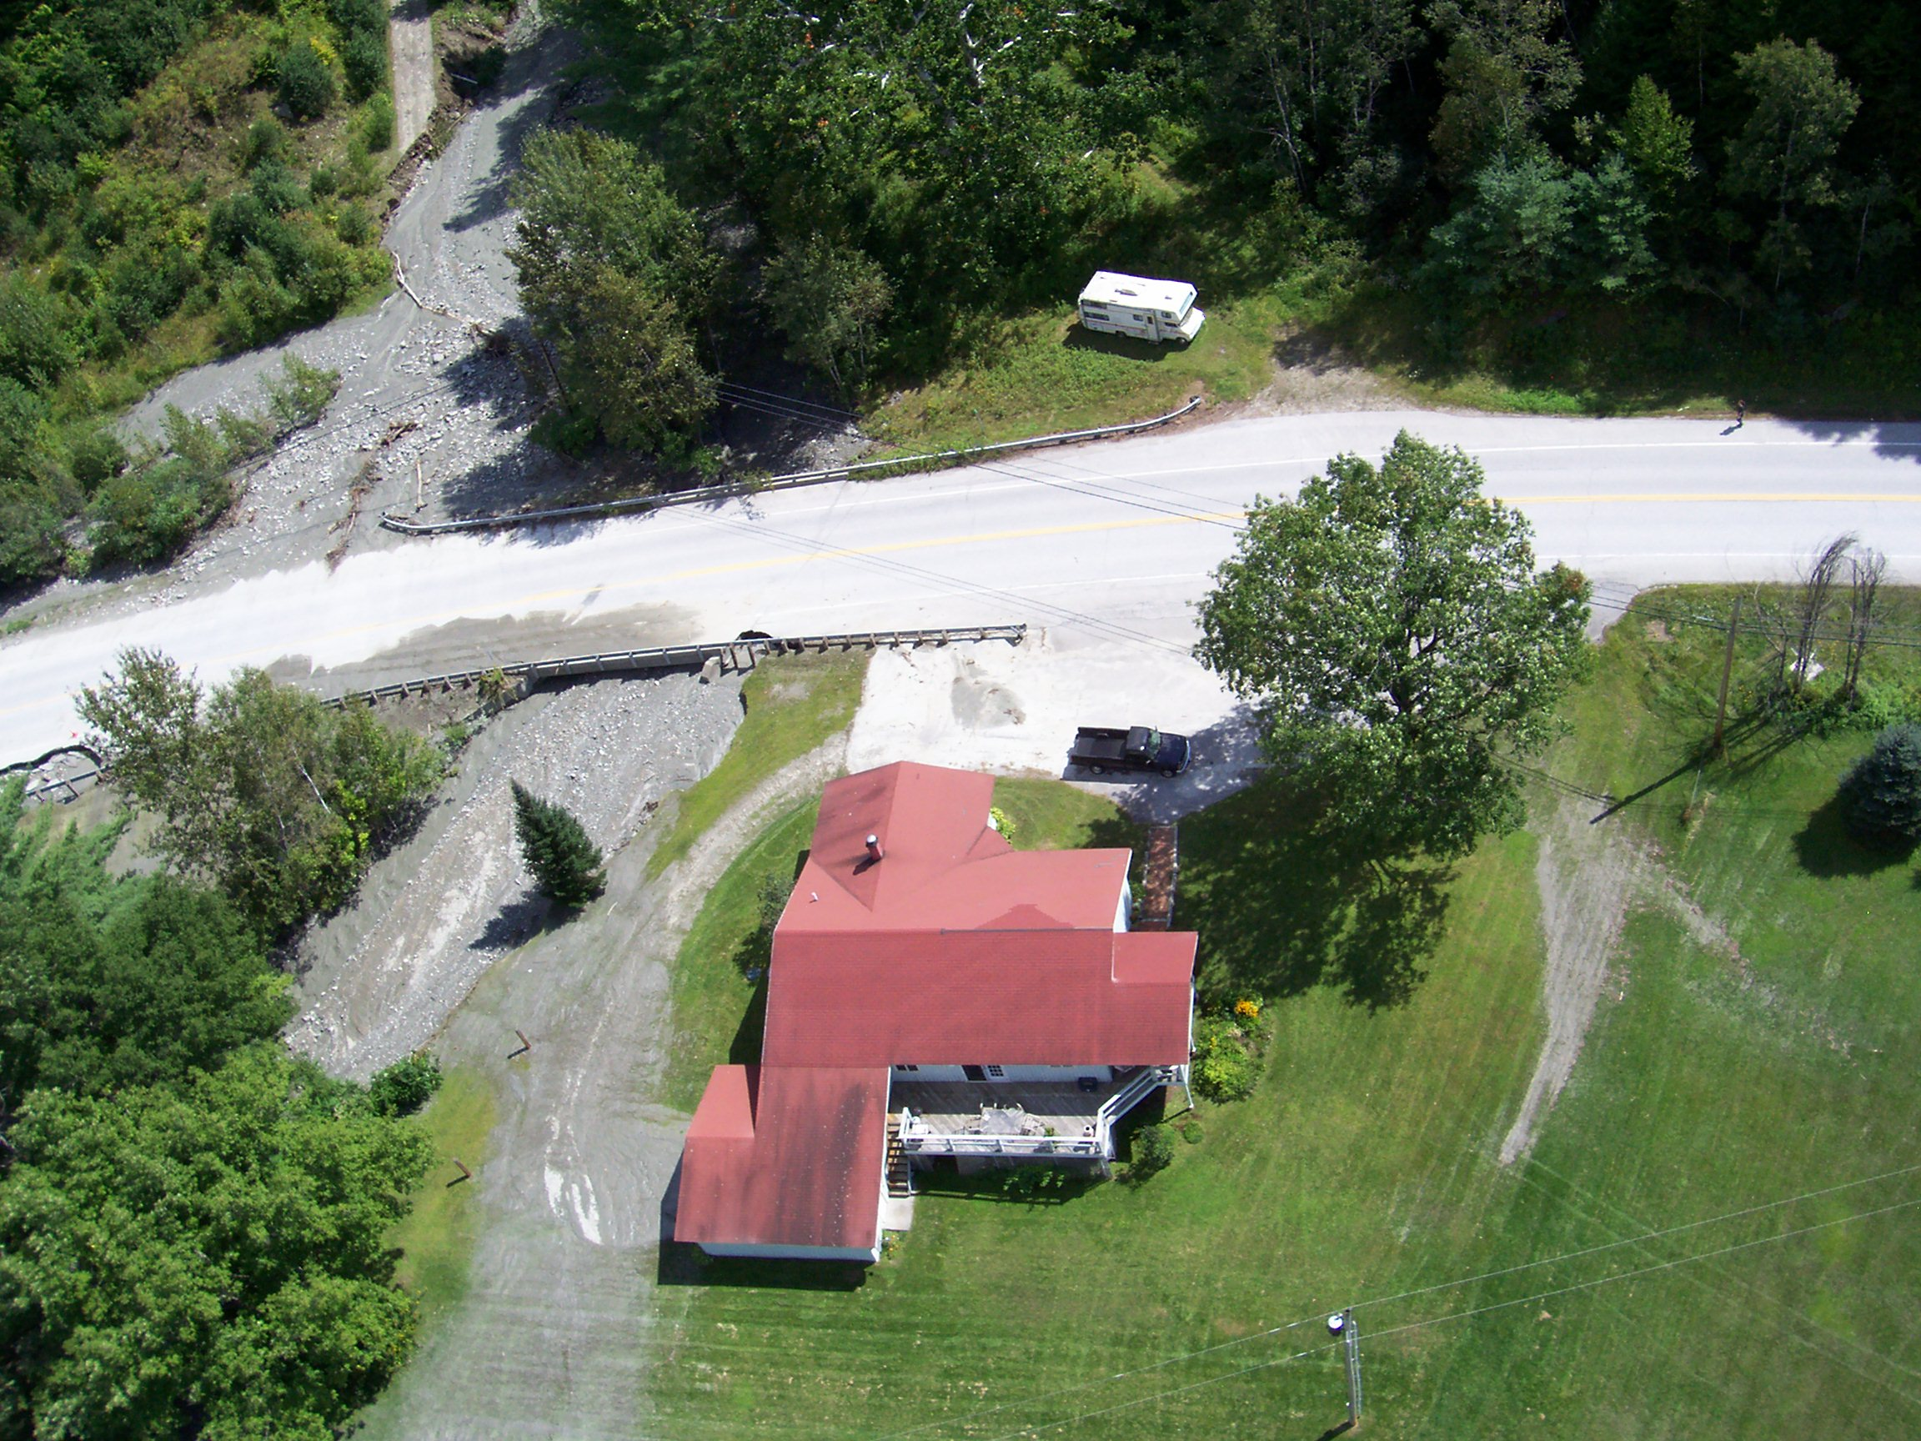

Slide 59
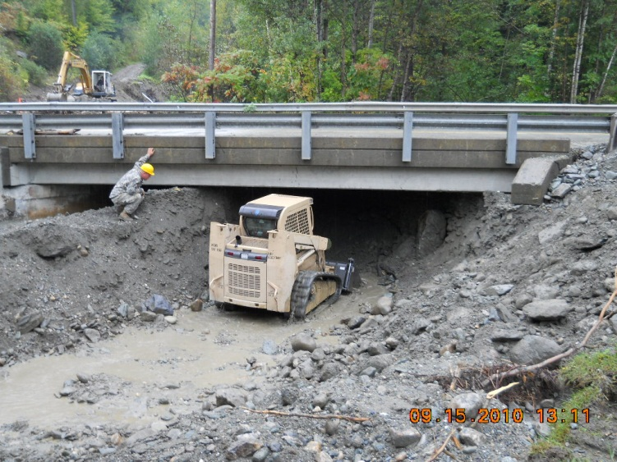

Slide 60
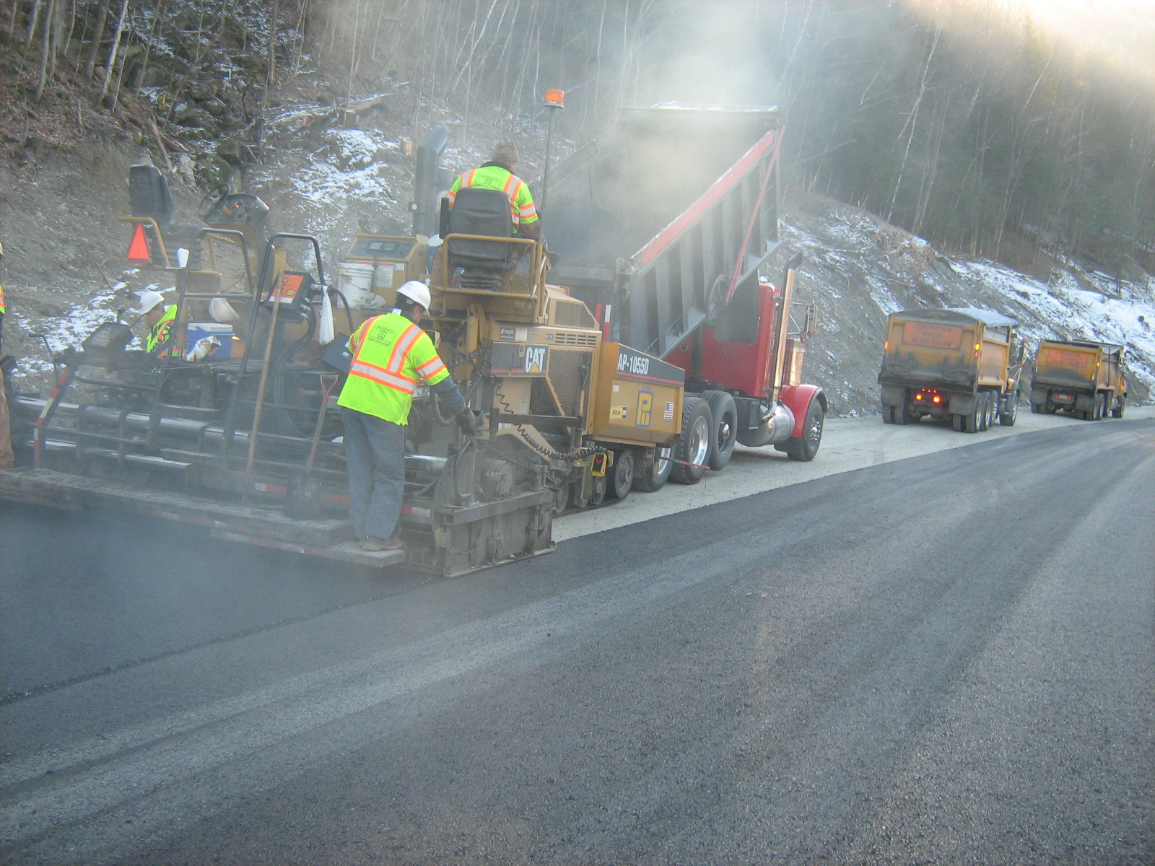

Slide 61
EMAC is a national disaster–relief compact signed into law in 1996 (Public Law 104-321). EMAC members includes all 50 states, the District of Columbia, Puerto Rico, Guam, and the U.S. Virgin Islands.

Slide 62
19 EMAC Missions
Estimated Cost $14.3 Million
12 States provided EMAC assistance (LA,IL,WV,NH,ME,VA,SC,OH,AR,MO,ID, and FL)
Total number of assisting EMAC Personnel – 780
Provided assistance to-
SEOC (EMAC A-Team Members)
Highway Repair
Commodity Distribution
Air Reconnaissance
Medical Support (MMRS)
Donations Management
Mitigation

Slide 63
Resources
Approximately 700 were assigned to IRENE recovery tasks
Hundreds of National Guard Troops:
Vermont – 200 people, numerous equipment
Maine – 220 people, numerous equipment, Command & Control function for out-of-state troops
Illinois - 145 troops, 8 aircraft, 23 vehicles
Ohio – 93 people, 29 pieces of equipment
New Hampshire – 8 people, 2 aircraft
South Carolina – 51 people, 23 pieces of equipment
West Virginia – 30 people, 10 pieces of equipment
Virginia – 16 people, 6 pieces of equipment
DOT Partners
Maine – 150 people, 145 pieces of equipment
New Hampshire – 75 people, 60 pieces of equipment
Over 200 Private Contractors and Consultants
Approximately 1800 people from the private sector, primarily from Vermont
Medical Assistance from LA, ME, AR, MO, NH, ID and FL
EOC, RPCs, Red Cross, Church groups, Fraternal Organizations, and many individuals
Thank You !!!

Slide 64
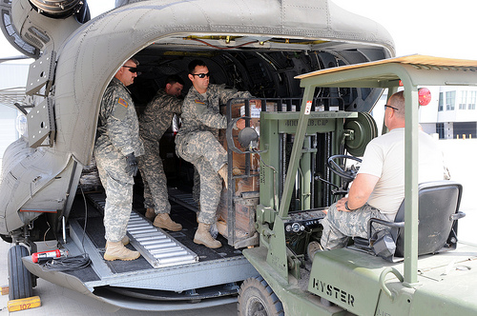
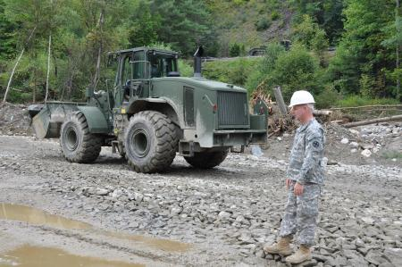
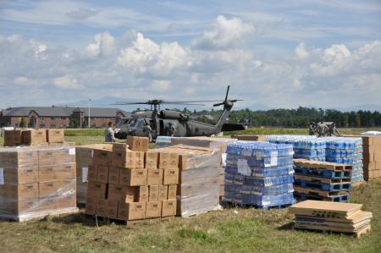
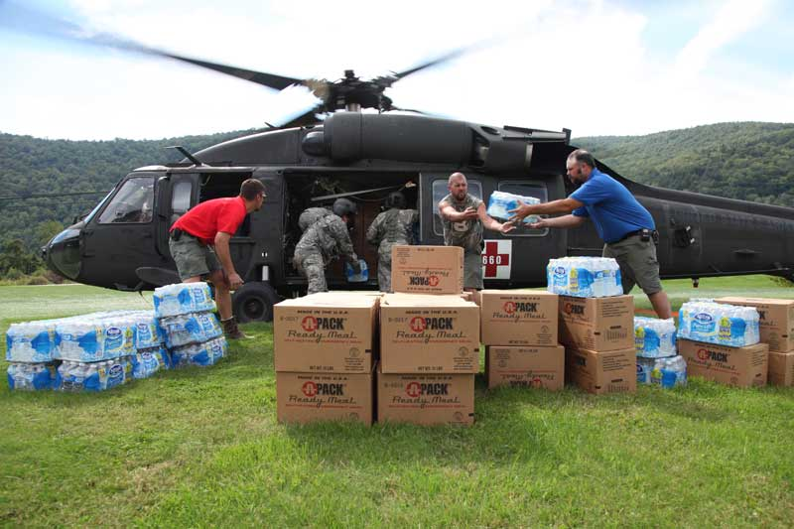
National Guard

Slide 68
AOT Secretary Brian Searles thanks NHDOT

Slide 71
Lessons Learned for Emergency Response
Use of ICS is crucial to success
Train all staff in ICS
Choose leaders early
Train leaders intensely
Enhance technology available to ICS leaders
Adopt SOP that incorporate structure of UC and role of IT

Slide 72
Irene Response Sparked Innovation
Use of cross-functional teams
Infusion of tech-savvy staff
Empowering staff to make decisions at local level
Each of these has potential to be useful in ongoing operations

Slide 73
High-Level Ways to Foster Innovation
Continue the deployment of cross-functional teams, IT emphasis, staff empowerment and urgency
Develop ideas to streamline design process
Close roads more frequently for repairs
Move from committees to Task Groups
Develop champions to test and implement change
Work to create a less risk-averse culture
Integrate planning and training efforts with resource agencies to build in a more flood resilient manner and streamline permitting processes

Slide 74
Credit: NASA Earth Observatory image captured September 2, 2011 by Robert Simmon, using Landsat 5 data from the US Geological Survey Global Visualization Viewer.
Irene Sediment Flowed Down
the Connecticut River into
Long Island Sound

Slide 75
vtstrong.vermont.gov/

Slide 76
Questions…?
Vermont Emergency Management
800-347-0488
http://vem.vermont.gov
https://www.facebook.com/vermontemergencymanagement

